Slide 1
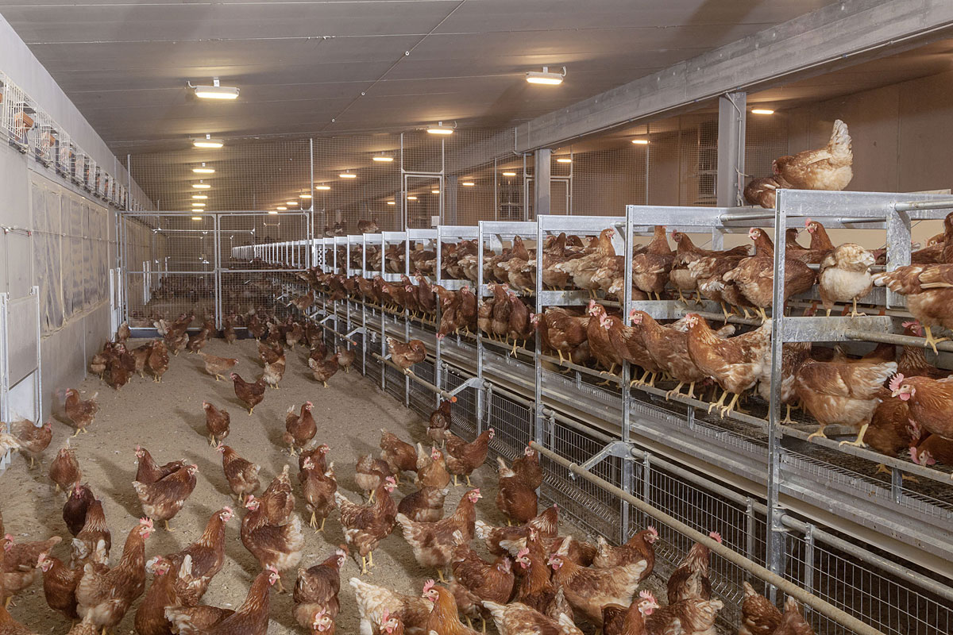
Coop
General Problematic
Ensure the ventilation and automatic lighting of a chiken coop farm, in order to optimize the development of its occupants.
My personal task
Acquiring the level of brightness and preventing the breeder from a lack of brightness in the coop
SIN:
Ralph AJAVON; Jérémy CARPENTIER; Hugo PREVOST;
Terminale STI2D3
M. COULÉON
EE:
Alexandre GEOFFROY
Romain MARCHAND

Slide 2
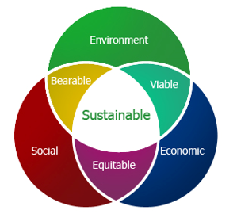
Sustainable Development
Environmental: Better breeding conditions and labels ( Energy and Health)
Social: Sensitize young people to the human impact on the earth, responsible consumption, saving time for the producer.
Economic: Reduced loads, renewable resources.

Slide 3
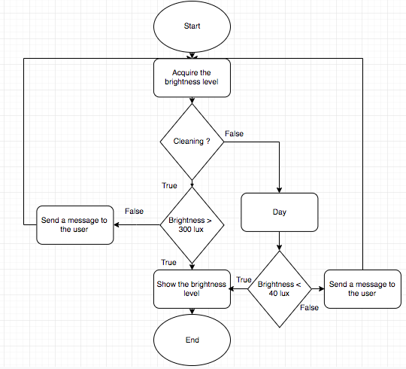
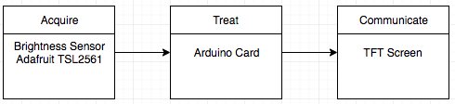
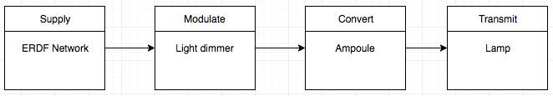
Solution
Information Chain
Energy Chain

Slide 4
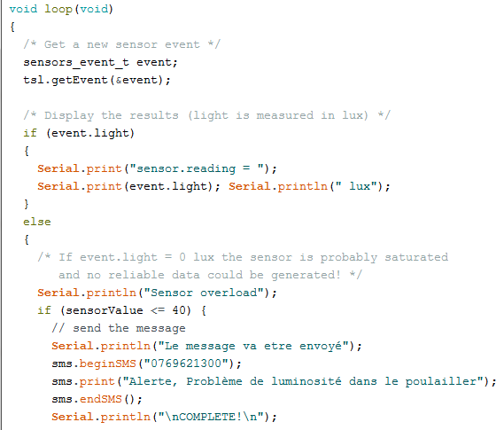
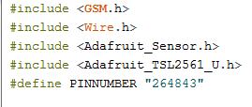
Programmation

Slide 5
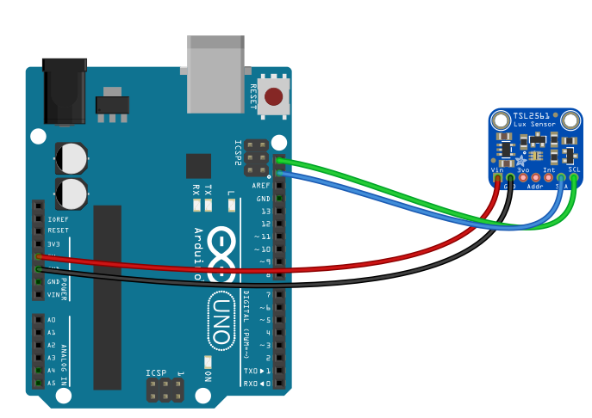
Why it works
This assembly works because the sensor is correctly connected to the Arduino board thanks to the tutorials on the sensor site.
It allows to measure the brightness and to send a message to the breeder in case of a lack of brightness in the coop.

